Slide 1

Building Modern Mobile Apps
Kevin Ford
Mobile Practice Lead
Magenic
Brent Edwards
Principal Lead Consultant
Magenic
Level: Intermediate

Slide 2
Kevin Ford
KevinF@magenic.com
@Bowman74
http://windingroadway.blogspot.com
https://github.com/Bowman74
BrentE@magenic.com
@brentledwards
http://www.brentedwards.net
https://github.com/brentedwards
Brent Edwards

Slide 3
Mobile Tasks Source Code
Github
https://github.com/brentedwards/MobileTasks

Slide 4
Today’s Goals
Introduce several ways to do mobile development
Each topic will start high level
Plant the seed of knowledge
Up to you to water it!

Slide 5
What is a modern mobile app?

Slide 6
Modern Mobile App
A Modern Mobile App will…
Work on user’s device(s)
No matter what that device/platform is
Securely store data in the cloud
Be kind to user’s data plan

Slide 7
Major Mobile players

Slide 8
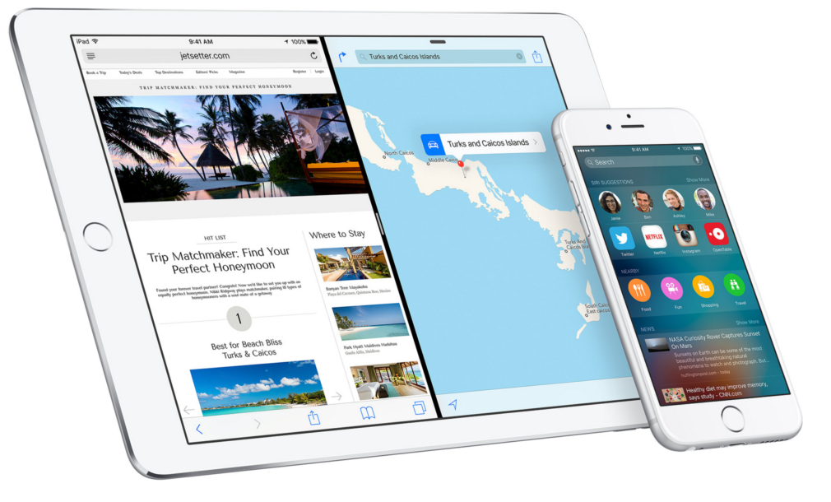
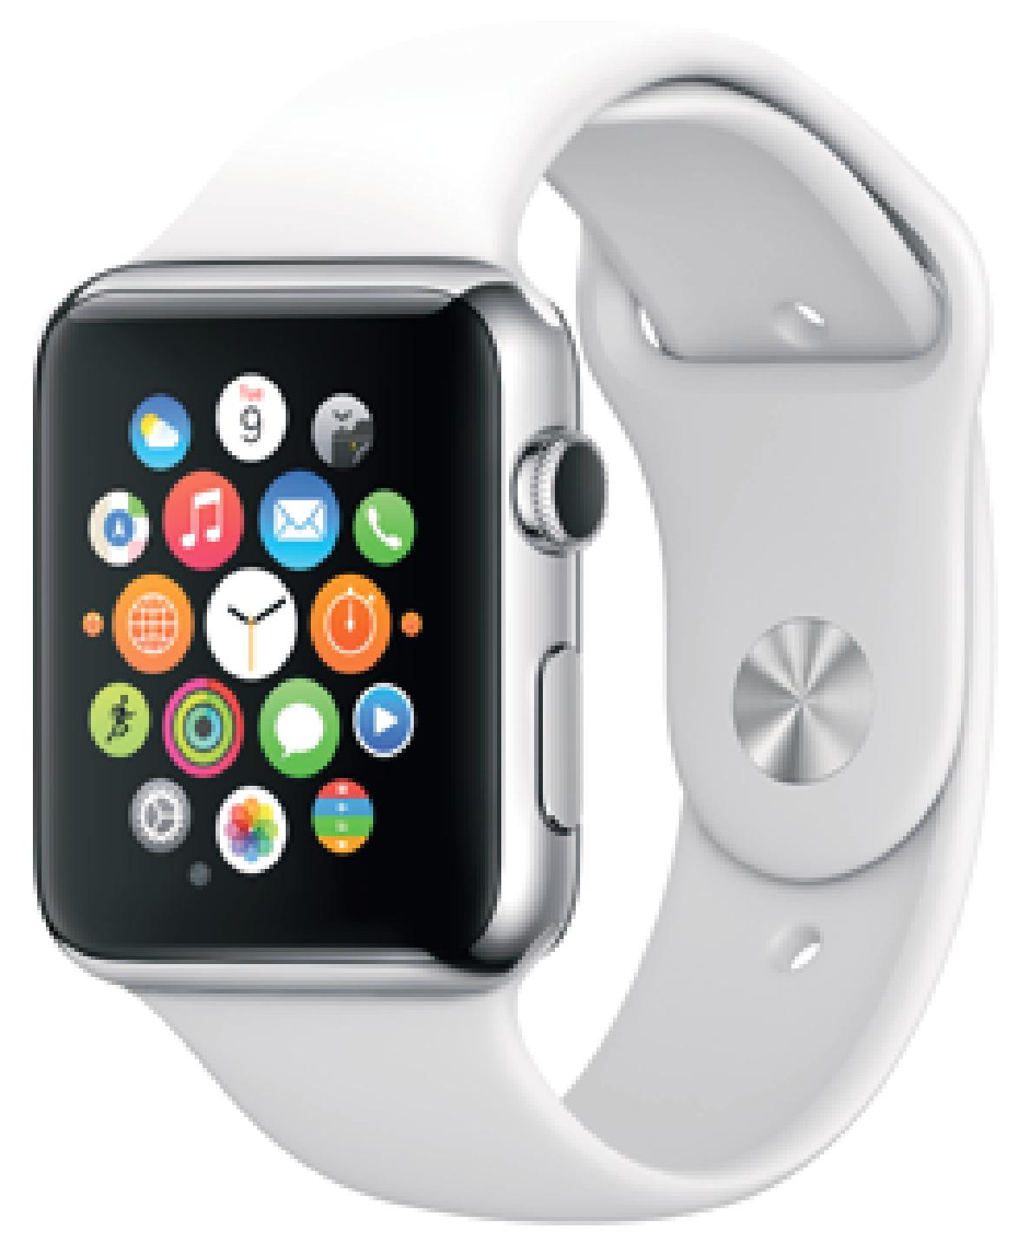
iOS
http://www.apple.com/ios/

Slide 9
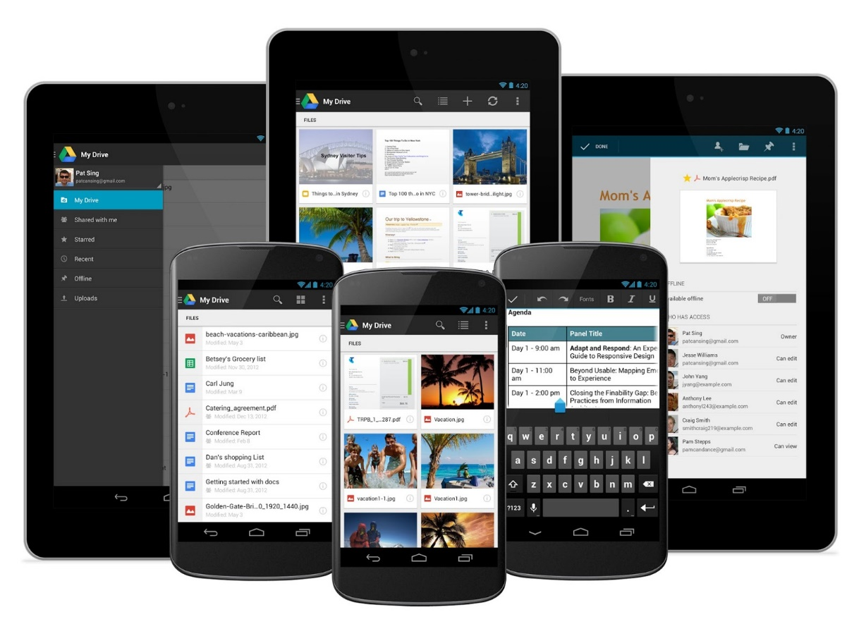
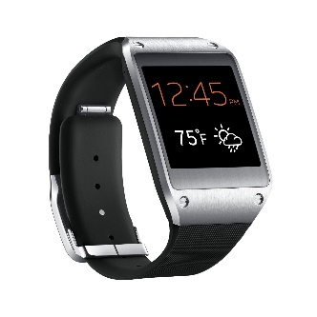
Android
http://www.auglaize.oplin.org/content/coming-march-kindle-fire-android-device-classes

Slide 10
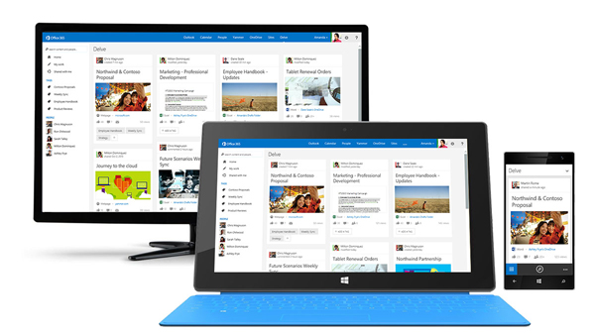
Windows
https://www.tescotechsupport.com/feature/windows-10-runs-android-devices/

Slide 11
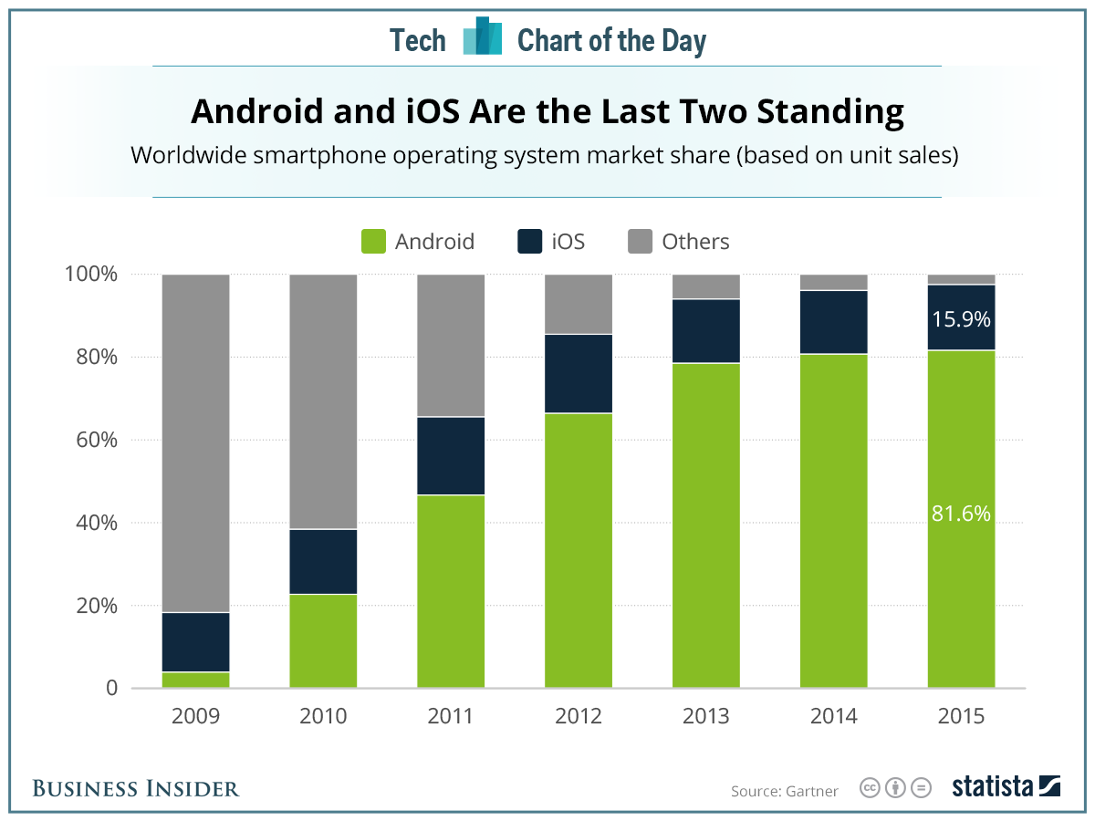
Platform Adoption
http://www.businessinsider.com/ios-and-android-dominate-marketshare-2016-2

Slide 12
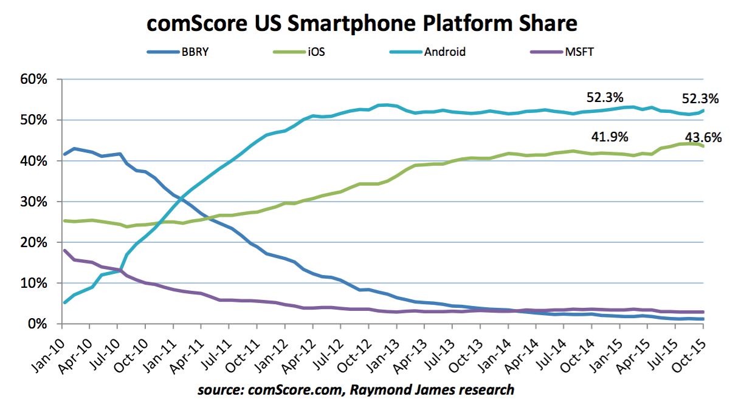
Platform Adoption
http://www.businessinsider.com/ios-and-android-dominate-marketshare-2016-2

Slide 13
Android

Slide 14
Android Challenges
Fragmentation
Device
Screen Size
Operating System Version
Being Noticed
1.6 Million Apps in Play Store
http://www.statista.com/statistics/276623/number-of-apps-available-in-leading-app-stores/

Slide 15
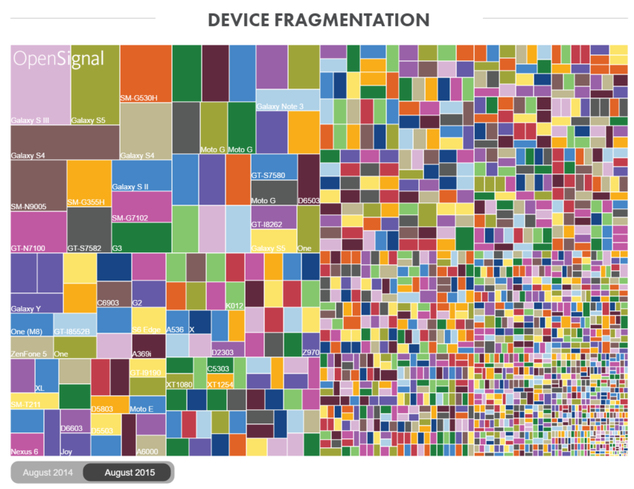
Android Fragmentation
http://opensignal.com/reports/2015/08/android-fragmentation/

Slide 16
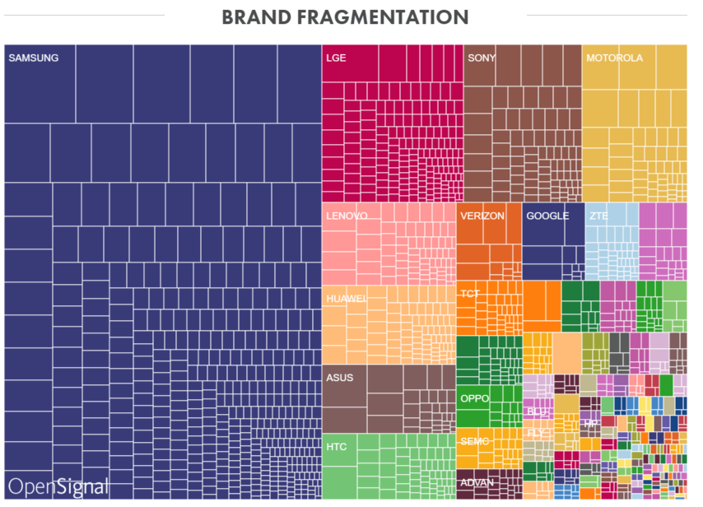
Android Fragmentation
http://opensignal.com/reports/2015/08/android-fragmentation/

Slide 17
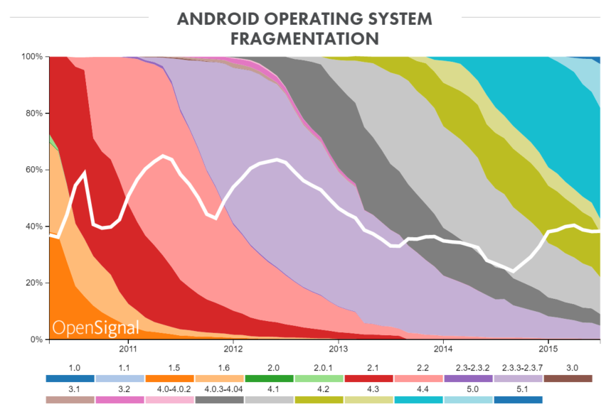
Android Fragmentation
http://opensignal.com/reports/2015/08/android-fragmentation/

Slide 18
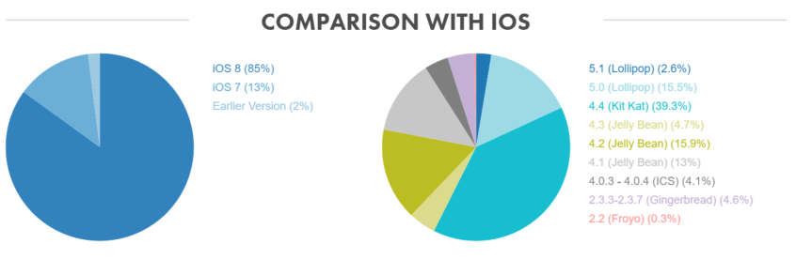
Android Fragmentation
http://opensignal.com/reports/2015/08/android-fragmentation/

Slide 19
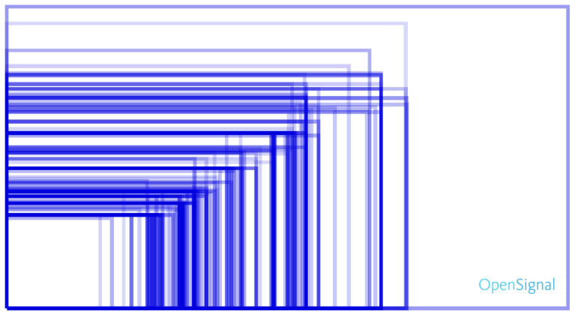
Android Fragmentation
http://opensignal.com/reports/2015/08/android-fragmentation/

Slide 20
iOS

Slide 21
iOS Challenges
Being Noticed
1.5 Million Apps in App Store
http://www.statista.com/statistics/276623/number-of-apps-available-in-leading-app-stores/
Multiple Screen Sizes
Not anywhere close to Android
Always need a Mac

Slide 22

iOS Challenges
http://opensignal.com/reports/2015/08/android-fragmentation/

Slide 23
Windows

Slide 24
Windows Challenges
Mobile Adoption
200 Million Windows 10 installs so far
http://www.engadget.com/2016/01/04/windows-10-200-million-installed-devices/
However, Windows Phone is still struggling
1.7% Market Share in 2015 Q3
http://betanews.com/2015/11/18/windows-phones-market-share-goes-into-freefall/

Slide 25
Development

Slide 26
Client App Options
Technology Options
Mobile Web
Fully Native
Cross-platform solution
Xamarin
Cordova

Slide 27
Tech Option: Mobile Web
Pros
Already lots of experience with web
Can reuse all code
Cons
No native look-and-feel out of the box

Slide 28
Tech Option: Fully Native
Pros
Native look-and-feel
Build apps as each platform intends
Cons
No code re-use

Slide 29
Tech Option: Cordova
Pros
Cross-platform
Lots of code re-use
Builds on Web dev knowledge
Don’t need Windows and Mac machines to build
Cons
Users can sometimes tell it’s not a “native” app

Slide 30
Tech Option: Xamarin
Pros
Native look-and-feel
Lots of code re-use
Cons
Can’t re-use UI code
Requires expensive license Not Anymore!
Need Windows and Mac machines to build

Slide 31
Tech Option: Xamarin.Forms
Pros
Pros of Xamarin
Can re-use UI code
Cons
Still need Windows and Mac machines to build

Slide 32
Today’s Agenda
Native Technologies
UWP
Swift
Android Studio
Lunch
Hybrid Development
Cordova
Near Native Development
Xamarin
Xamarin.Forms
Wrapping Up

Slide 33
Questions?

